Slide 1

Exam AZ-801: Configuring Windows Server Hybrid Advanced Services Crash Course
Tim Warner

Slide 2

Tim Warner
Based in Nashville, TN, US
Central time zone
26-year Microsoft Certified Trainer (MCT); former MVP and MSFT
LinkedIn: timw.info/li
Badge: TechTrainerTim.com

Slide 3
Class Agenda
Introduction
Windows Server hybrid security
Windows Server high availability
Disaster Recovery (start)

Slide 4
Class Materials
timw.info/az801

Slide 5
Break Schedule (Central time)
07:00am - Start
08:00am - 8-min break
09:00am - 8-min break
10:00am - 8-min break
11:00am - 8-min break
12:00pm - Finish

Slide 6
Class Expectations
The Hybrid Administrator Associate badge is not an introductory certification
Please review the recordings…several times!
10-minute break at midpoint
I’m here to answer your questions – take advantage of this
Use the Q&A panel

Slide 7

Class Recording

Slide 8

Session Recordings

Slide 9


Mobile Browser: learning.oreilly.com

Slide 10



O'Reilly Mobile App

Slide 11

Microsoft Certification Tiers

Slide 12
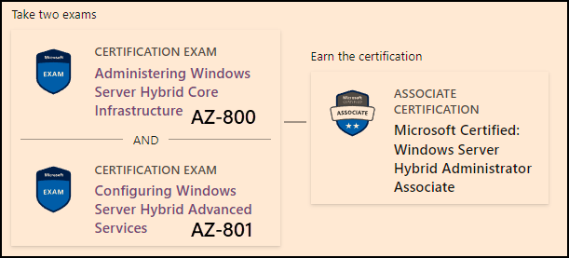
Windows Server Hybrid Admin Assoc.
1-year cert validity

Slide 13

Tim's Certification Study Model

Slide 14
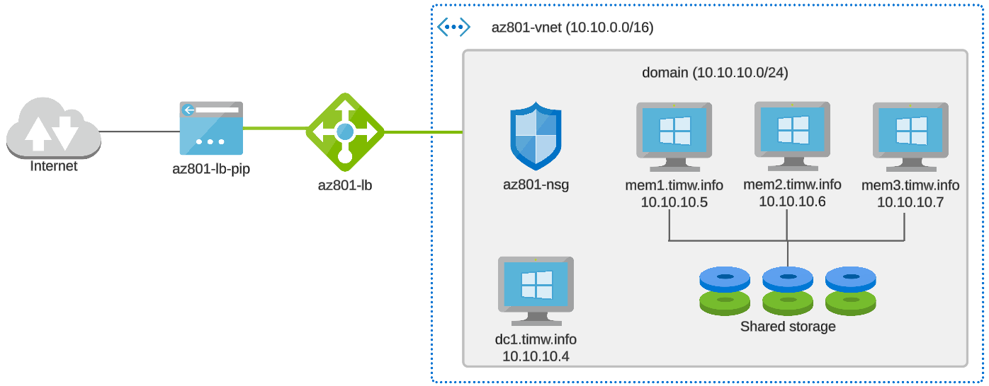
Class Topology

Slide 15
Thank you!
Course materials: timw.info/az801
LinkedIn: timw.info/li

Slide 16
Security

Slide 17
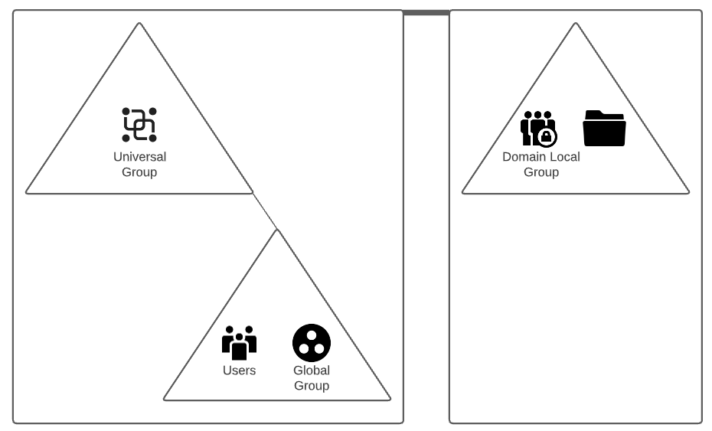

AD Group Security Best Practices

Slide 18
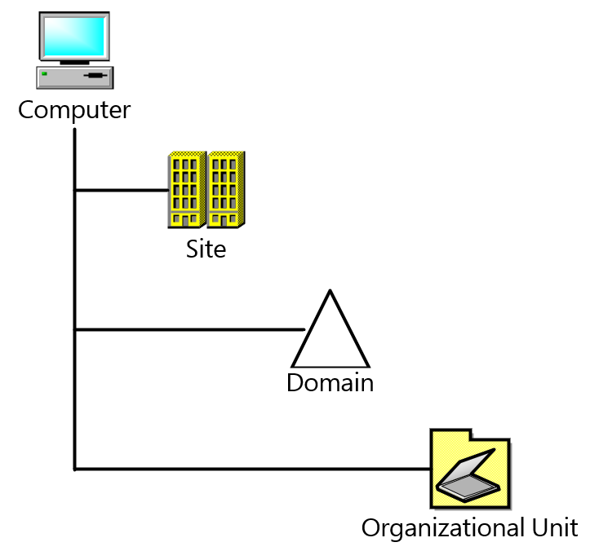
Group Policy Scope (L-S-D-OU)

Slide 19
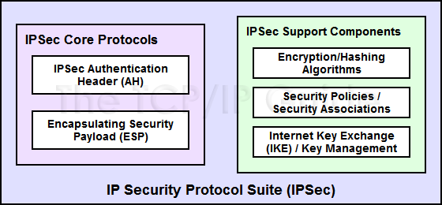
IPSec Components
Citation: timw.info/axu

Slide 20
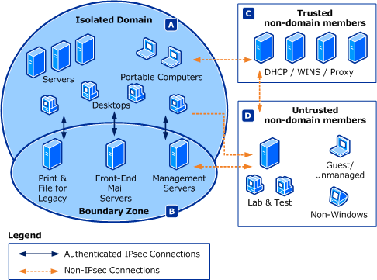
Connection Security Rules

Slide 21
High Availability

Slide 22
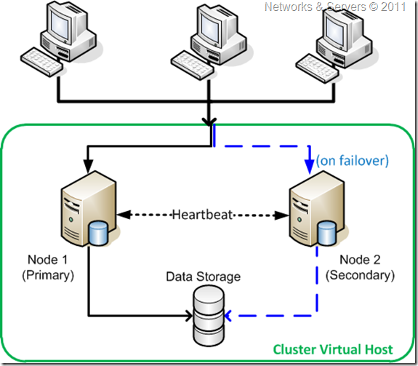
Failover Clustering
Ref: timw.info/ga6

Slide 23
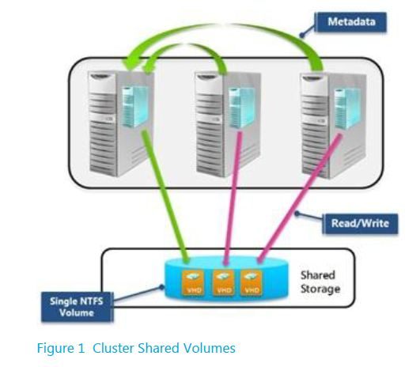
Cluster Shared Volumes (CSVs)
Ref: timw.info/ai4

Slide 24
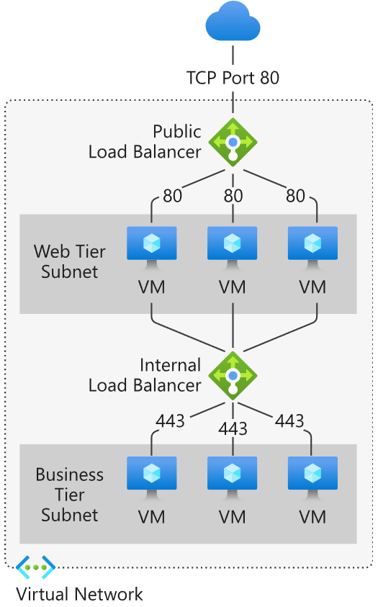
Azure Load Balancer
Ref: timw.info/0fx

Slide 25
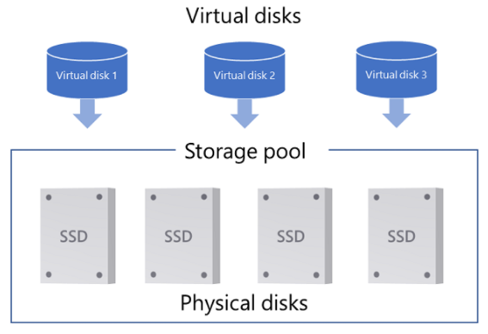
Storage Spaces Direct (S2D)
Ref: timw.info/mhx

Slide 26
Disaster Recovery

Slide 27

Azure Backup
Ref: timw.info/air

Slide 28

Azure Site Recovery

Slide 29
Migration

Slide 30
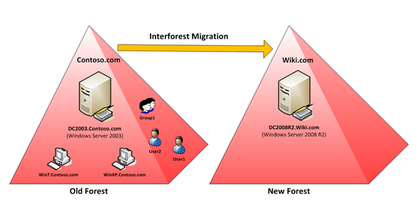
Active Directory Migration Tool (ADMT)
Ref: timw.info/in1

Slide 31
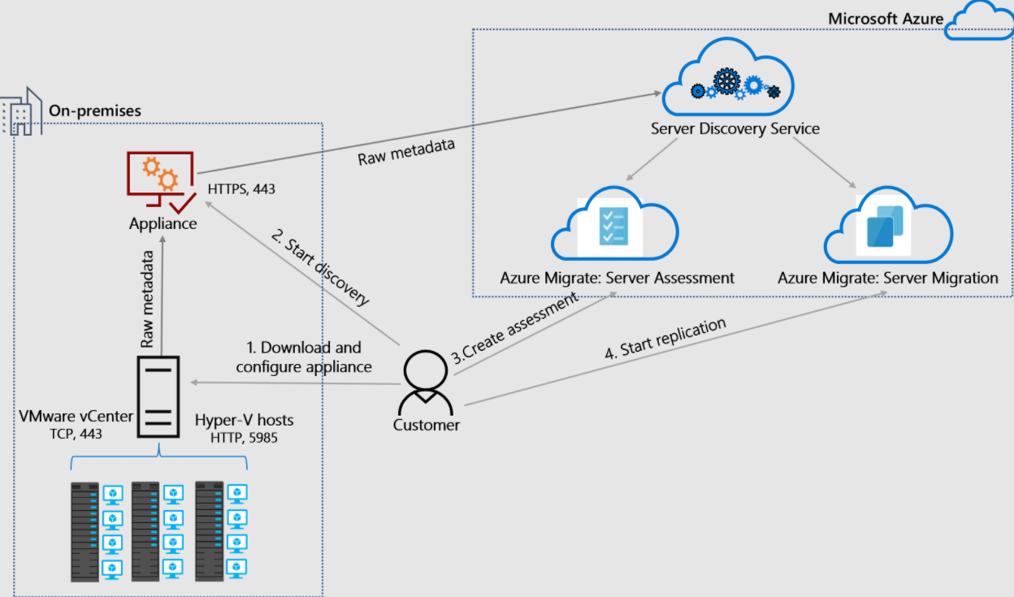
Azure Migrate Server Migration
Ref: timw.info/fng

Slide 32
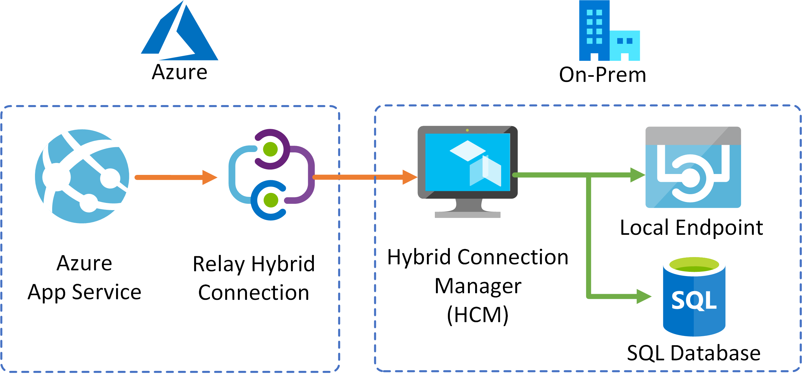
App Service Hybrid Connection
Ref: timw.info/pqk

Slide 33
Monitoring

Slide 34
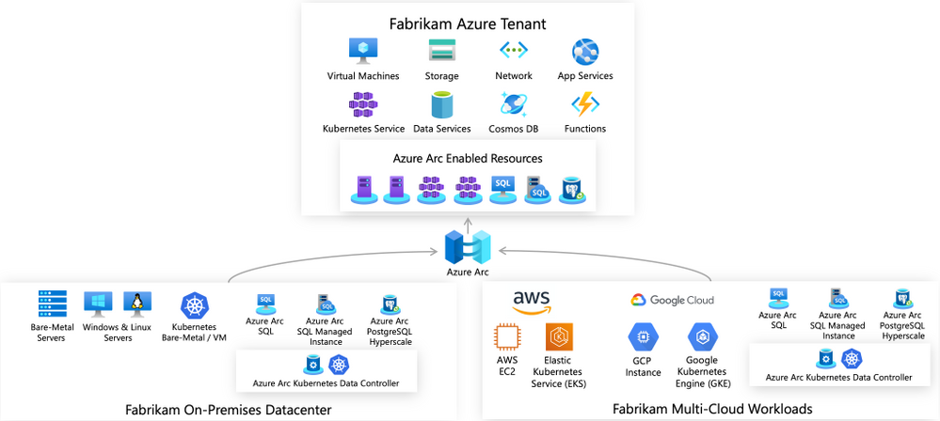
Azure Arc-Enabled Servers
Ref: timw.info/7sn

Slide 35
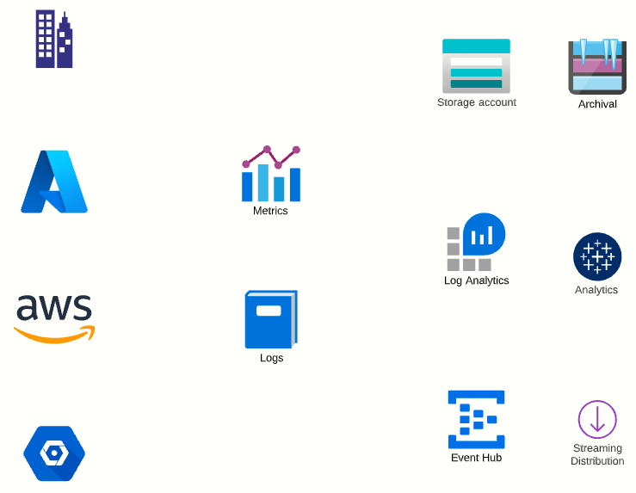
Diagnostics Settings

Slide 36
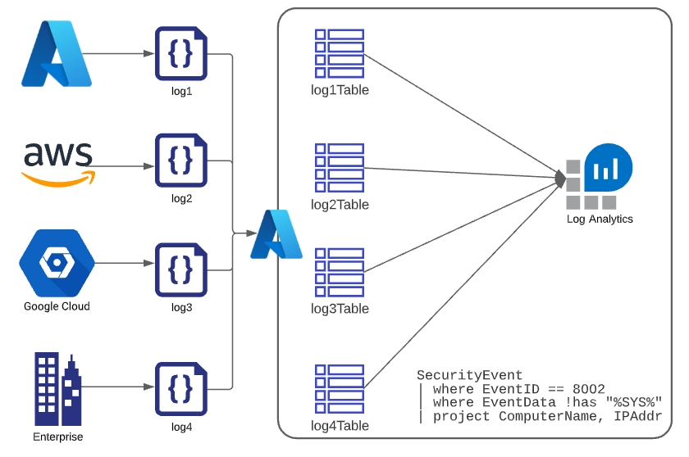
Azure Log Analytics

Slide 37
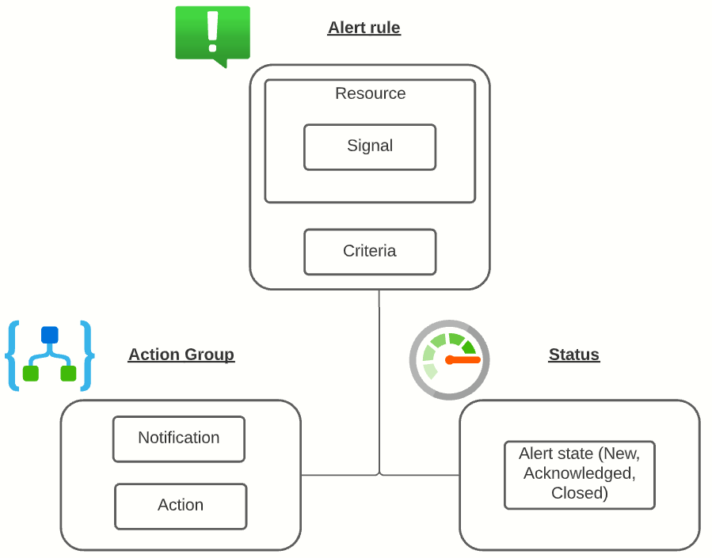
Azure Alert Logic

Slide 38
Exam Prep

Slide 39


Single-Answer Multiple Choice

Slide 40

Multiple Answer Multiple Choice

Slide 41
Repeated Scenario
You need to move an Azure VM to another hardware host.
Solution: You redeploy the VM.
Does this solution meet the goal?
Yes
No

Slide 42
Repeated Scenario
You need to move an Azure VM to another hardware host.
Solution: You create a proximity placement group.
Does this solution meet the goal?
Yes
No

Slide 43

Select and Place

Slide 44

Build List and Reorder

Slide 45
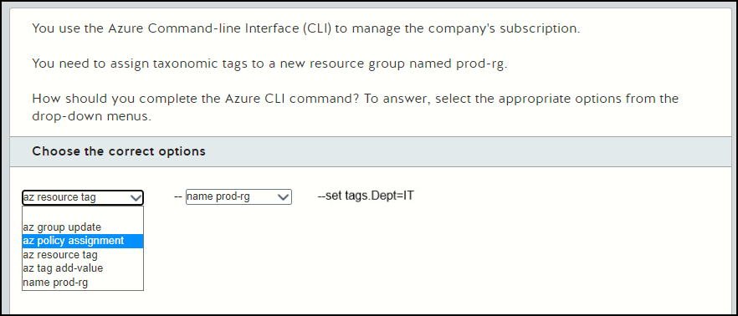
Active Screen

Slide 46

Case Study

Slide 47






Performance-Based Lab

Slide 48
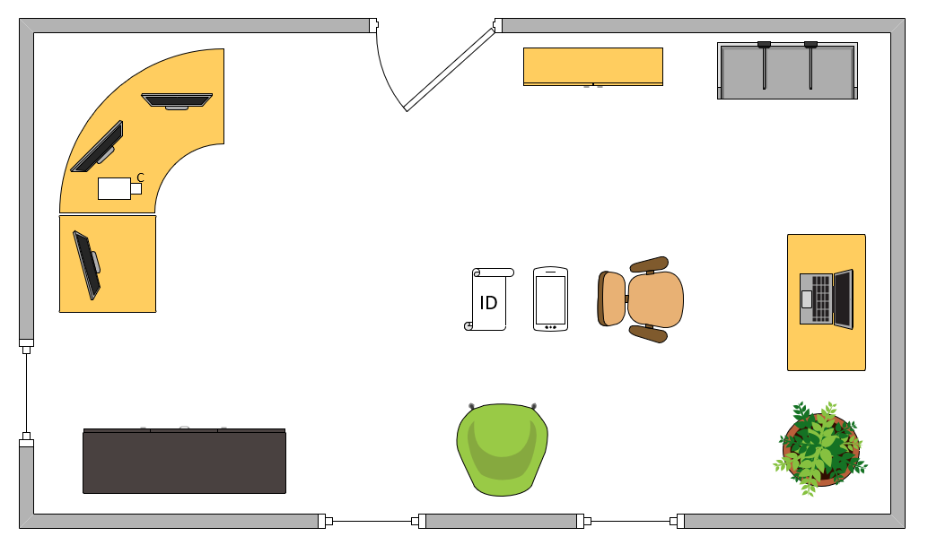
Ideal Testing Room

Slide 49
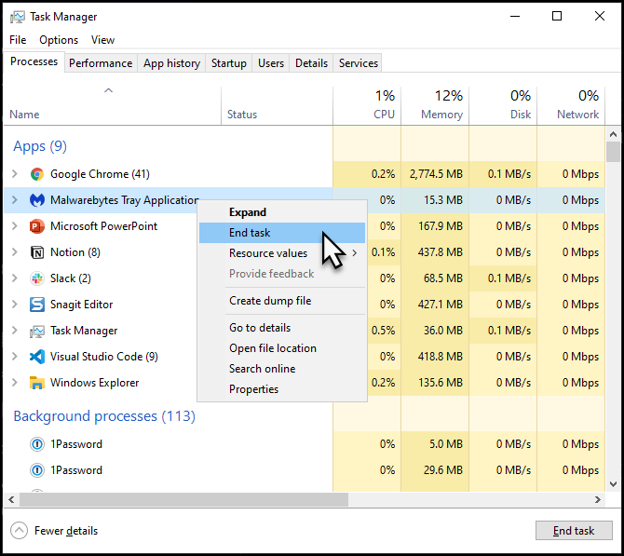
Kill Those Background Processes!
All foreground apps except OnVUE
Pause Windows Update
Stop antimalware (!)
Stop GameBar*

